Slide 1
CSCI2100D Tutorial 2
Fangyuan ZHANG
Department of Systems Engineering and Engineering Management
Chinese University of Hong Kong

Slide 2
Outline
Divide and Conquer Example: Majority Element
Singly Linked List

Slide 3
Outline
Divide and Conquer Example: Majority Element
Singly Linked List

Slide 4
Recap Divide and Conquer
Basic Idea of Divide and Conquer
If the problem is easy, solve it directly
If the problem cannot be solved as it is, divide the problem into smaller parts, and solve the smaller parts

Slide 5
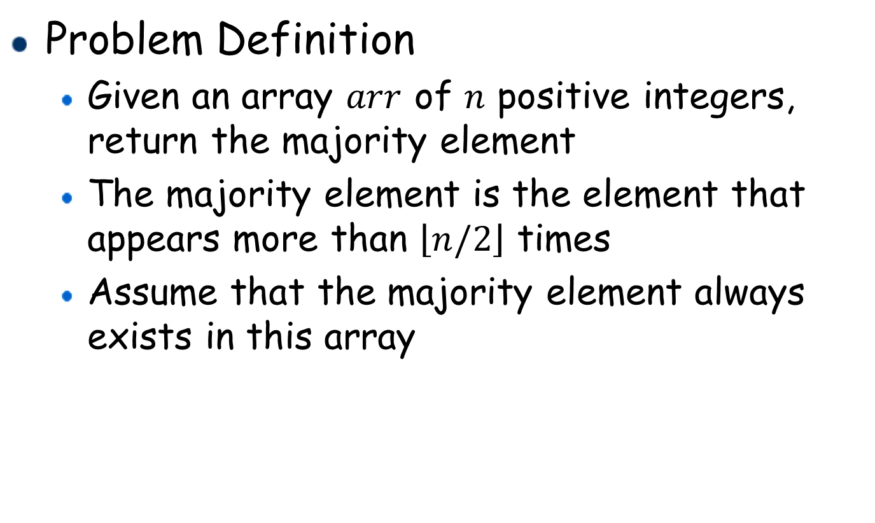
Majority Element (i)
Problem Definition
Given an array $arr$ of $n$ positive integers, return the majority element
The majority element is the element that appears more than $\left\lfloor n/2\right\rfloor$ times
Assume that the majority element always exists in this array

Slide 6

Majority Element (ii)
Example
Input: $arr=[3,2,3]$, Output: $3$
Input: $arr=[2,2,1,1,2,3,2]$, Output: $2$

Slide 7
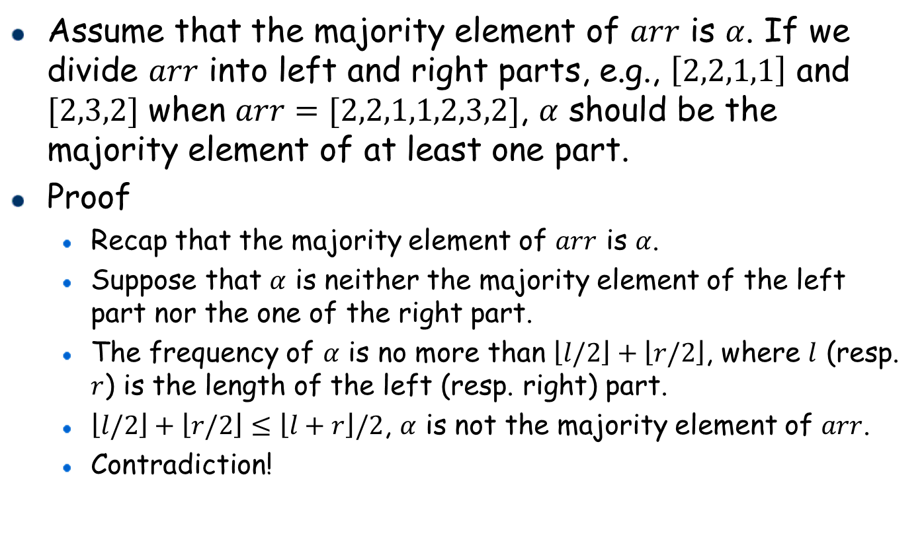
Main Idea
Assume that the majority element of $arr$ is $α$. If we divide $arr$ into left and right parts, e.g., $\left[2,2,1,1\right]$ and $[2,3,2]$ when $arr=[2,2,1,1,2,3,2]$, $α$ should be the majority element of at least one part.
Proof
Recap that the majority element of $arr$ is $α$.
Suppose that $α$ is neither the majority element of the left part nor the one of the right part.
The frequency of $α$ is no more than $\left\lfloor l/2\right\rfloor +\left\lfloor r/2\right\rfloor$, where $l$ (resp. $r$) is the length of the left (resp. right) part.
$\left\lfloor l/2\right\rfloor +\left\lfloor r/2\right\rfloor ≤\left\lfloor l+r\right\rfloor /2$, $α$ is not the majority element of $arr$.
Contradiction!

Slide 8
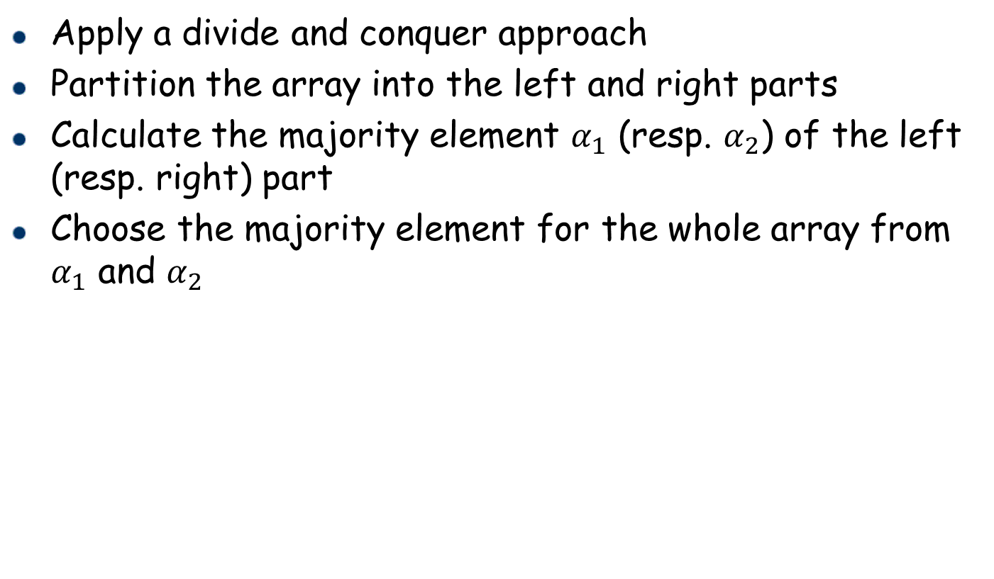
Main Idea (cont.)
Apply a divide and conquer approach
Partition the array into the left and right parts
Calculate the majority element $α_{1}$ (resp. $α_{2}$) of the left (resp. right) part
Choose the majority element for the whole array from $α_{1}$ and $α_{2}$

Slide 9
Solution
Recurse on the left and right parts of an array until an answer can be trivially achieved for an array with one element.
Base case: the majority element for an array with one element is this only element.
Recursive step:
Combine the answers for the left and right parts.
If they agree on the majority element, then the majority element for the combined array is obviously the same.
If they disagree, only one of them can be "right", so we need to count the occurrences of the left and right majority elements to determine which part's answer is globally correct.

Slide 10
An Example (1)
Step 1: Partition the initial array into two subarrays.
2 2 1 1⏐2 3 2 → 1 2 3 4 6 7 8 9
2
3 8 6 1 → 1 3 8 6
9 4 → 4 9
3 8 → 3 8
6 1 → 1 6
2
9
3 → 3
8 → 8
6 → 6
1 → 1

Slide 11
An Example (2)
Step 1: Partition the initial array into two subarrays.
Step 2: Find the majority element
If the array only has one element, the majority element of this array is this only one element.
Otherwise, return to Step 1 to find the majority element.
2 2 1 1⏐2 3 2 → 1 2 3 4 6 7 8 9
2 2⏐1 17 2
3 8 6 1 → 1 3 8 6
9 4 → 4 9
3 8 → 3 8
6 1 → 1 6
2
9
3 → 3
8 → 8
6 → 6
1 → 1

Slide 12
An Example (3)
Step 1: Partition the initial array into two subarrays.
Step 2: Find the majority element
If the array only has one element, the majority element of this array is this only one element.
Otherwise, return to Step 1 to find the majority element.
2 2 1 1⏐2 3 2 → 1 2 3 4 6 7 8 9
2 2⏐1 17 2
3 8 6 1 → 1 3 8 6
2⏐2
9 4 → 4 9
3 8 → 3 8
6 1 → 1 6
2
9
3 → 3
8 → 8
6 → 6
1 → 1

Slide 13


An Example (4)
Step 1: Partition the initial array into two subarrays.
Step 2: Find the majority element
If the array only has one element, the majority element of this array is this only one element.
Otherwise, return to Step 1 to find the majority element.
2 2 1 1⏐2 3 2 → 1 2 3 4 6 7 8 9
2 2⏐1 17 2
3 8 6 1 → 1 3 8 6
2⏐2
9 4 → 4 9
3 8 → 3 8
6 1 → 1 6
2$→$2
2$→$2 2
9
3 → 3
8 → 8
6 → 6
1 → 1

Slide 14

An Example (5)
Step 3: Combine the answers for the left and right parts.
If they agree on the majority element, then the majority element for the combined array is obviously the same.
If they disagree, only one of them can be "right", so we need to count the occurrences of the left and right majority elements to determine which part's answer is globally correct.
2 2 1 1⏐2 3 2 → 1 2 3 4 6 7 8 9
2 2⏐1 17 2
3 8 6 1 → 1 3 8 6
2⏐2 $→$ 2
9 4 → 4 9
3 8 → 3 8
6 1 → 1 6
2$→$2
2$→$2 2
9
3 → 3
8 → 8
6 → 6
1 → 1

Slide 15




An Example (6)
Step 1: Partition the initial array into two subarrays.
Step 2: Find the majority element
If the array only has one element, the majority element of this array is this only one element.
Otherwise, return to Step 1 to find the majority element.
Step 3: Combine the answers for the left and right parts.
2 2 1 1⏐2 3 2 → 1 2 3 4 6 7 8 9
2 2⏐1 1 on
3 8 6 1 → 1 3 8 6
2⏐2 $→$ 2
1⏐1 $→$ 11
3 8 → 3 8
6 1 → 1 6
2$→$2
2$→$2 2
1$→$1
1$→$1
3 → 3
8 → 8
6 → 6
1 → 1

Slide 16

An Example (7)
Step 1: Partition the initial array into two subarrays.
Step 2: Find the majority element
If the array only has one element, the majority element of this array is this only one element.
Otherwise, return to Step 1 to find the majority element.
Step 3: Combine the answers for the left and right parts.
2 2 1 1⏐2 3 2 → 1 2 3 4 6 7 8 9
2 2⏐1 1 $→$ -1
3 8 6 1 → 1 3 8 6
2⏐2 $→$ 2
1⏐1 $→$ 11
3 8 → 3 8
6 1 → 1 6
2$→$2
2$→$2 2
1$→$1
1$→$1
3 → 3
8 → 8
6 → 6
1 → 1

Slide 17






An Example (8)
Step 1: Partition the initial array into two subarrays.
Step 2: Find the majority element
If the array only has one element, the majority element of this array is this only one element.
Otherwise, return to Step 1 to find the majority element.
Step 3: Combine the answers for the left and right parts.
2 2 1 1⏐2 3 22 3 4 6 7 8 9
2 2⏐1 1 $→$ -1
2 3⏐2 $→$ 2
2⏐2 $→$ 2
1⏐1 $→$ 11
2⏐3 $→$ -1
2 $→$ 2
2$→$2
2$→$2 2
1$→$1
1$→$1
2$→$23
3$→$3

Slide 18



An Example (9)
Step 1: Partition the initial array into two subarrays.
Step 2: Find the majority element
If the array only has one element, the majority element of this array is this only one element.
Otherwise, return to Step 1 to find the majority element.
Step 3: Combine the answers for the left and right parts.
2 2 1 1⏐2 3 2 $→$ 2 2 3 4 6 7 8 9
2 2⏐1 1 $→$ -1
2 3⏐2 $→$ 2
2⏐2 $→$ 2
1⏐1 $→$ 11
2⏐3 $→$ -1
2 $→$ 2
2$→$2
2$→$2 2
1$→$1
1$→$1
2$→$23
3$→$3

Slide 19
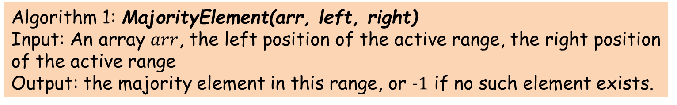
Implementation with Recursion
Algorithm 1: MajorityElement(arr, left, right)
Input: An array $arr$, the left position of the active range, the right position of the active range
Output: the majority element in this range, or $−1$ if no such element exists.
1 if (left == right) // base case
2 return arr[left];
3 int middle = (left + right) / 2;
4 int left_majority = MajorityElement(arr, left, middle);
5 int right_majority = MajorityElement(arr, middle + 1, right);
6 if (left_majority == right_majority)
7 return left_majority;
8 if (CountInRange(arr, left_majority, left, right) > (right – left + 1) / 2)
9 return left_majority;
10 if (CountInRange(arr, right_majority, left, right) > (right – left + 1) / 2)
11 return right_majority;
12 return -1;

Slide 20
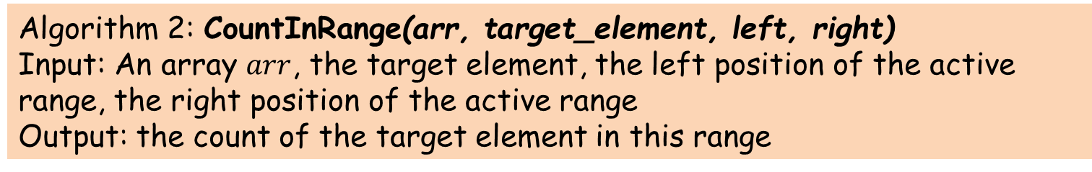
Implementation with Recursion
Algorithm 2: CountInRange(arr, target_element, left, right)
Input: An array $arr$, the target element, the left position of the active range, the right position of the active range
Output: the count of the target element in this range
1 int count = 0;
2 for (int i = left; i <= right; i++) {
3 if (arr[i] == target_element)
4 count++;
5 }
6 return count;

Slide 21
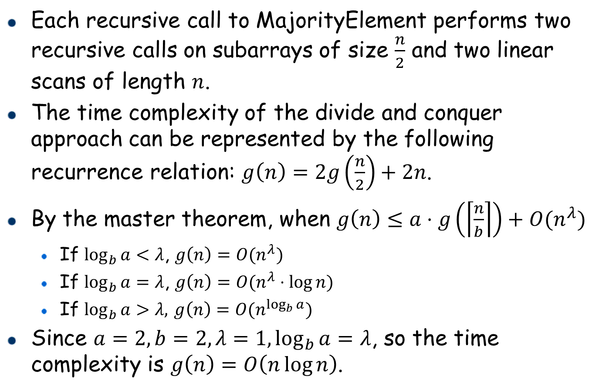
Time complexity
Each recursive call to MajorityElement performs two recursive calls on subarrays of size $\frac{n}{2}$ and two linear scans of length $n$.
The time complexity of the divide and conquer approach can be represented by the following recurrence relation: $g\left(n\right)=2g\left(\frac{n}{2}\right)+2n$.
By the master theorem, when $g\left(n\right)≤a⋅g\left(\left\lceil \frac{n}{b}\right\rceil \right)+O(n^{λ})$
If $\log_{b}{a}<λ$, $g\left(n\right)=O(n^{λ})$
If $\log_{b}{a}=λ$, $g\left(n\right)=O(n^{λ}⋅\log{n})$
If $\log_{b}{a}>λ,$ $g\left(n\right)=O(n^{\log_{b}{a}})$
Since $a=2,b=2,λ=1,\log_{b}{a}=λ$, so the time complexity is $g\left(n\right)=O\left(n\log{n}\right)$.

Slide 22
Outline
Divide and Conquer Example: Majority Element
Singly Linked List

Slide 23
Singly Linked List
A singly linked list is a concrete data structure consisting of a sequence of nodes
Each node stores
A data component
A pointer (or a link) to
the next node
The last node points to NULL
NULL = 0
Meaning that this pointer is empty
Example: C code
1
2
3
4
typedef struct listNode { int data; struct listNode* link; } listNode;
data
link
12
20
40
∅
n1
n2
n3

Slide 24
Singly Linked List: Initialization
Initialization: We only need to maintain starting position
The remaining nodes can be accessed one after another using the links.
1
2
3
typedef struct llist { listNode* head; } llist;
C code
Initializing a list with a single node
C code
1
2
3
4
5
llist* list1ptr = (llist*)malloc(1*sizeof(llist));
listNode* newNode = (listNode*)malloc(1*sizeof(listNode));
newNode->data = 10;
newNode->link = NULL;
list1ptr->head = newNode;
10
∅
list1ptr->head
A new node

Slide 25
Warmup: Prepend Operation
Prepend: Add a new node to make it the first node in the sequence.
Step 1: allocate a new node.
Step 2: update new node
Step 3: make the new node
point to the old head
Step 4: update the head to
point to the new node
Algorithm 3: prepend(data, list)
1
2
3
4
5
6
7
8
9
temp ← new allocated node
temp.data ← data
if list.head = NULL
temp.link ← NULL
list.head ← temp
return
temp.link ← list.head
list.head ← temp
return
list.head
list.head
5
12
20
40
∅

Slide 26
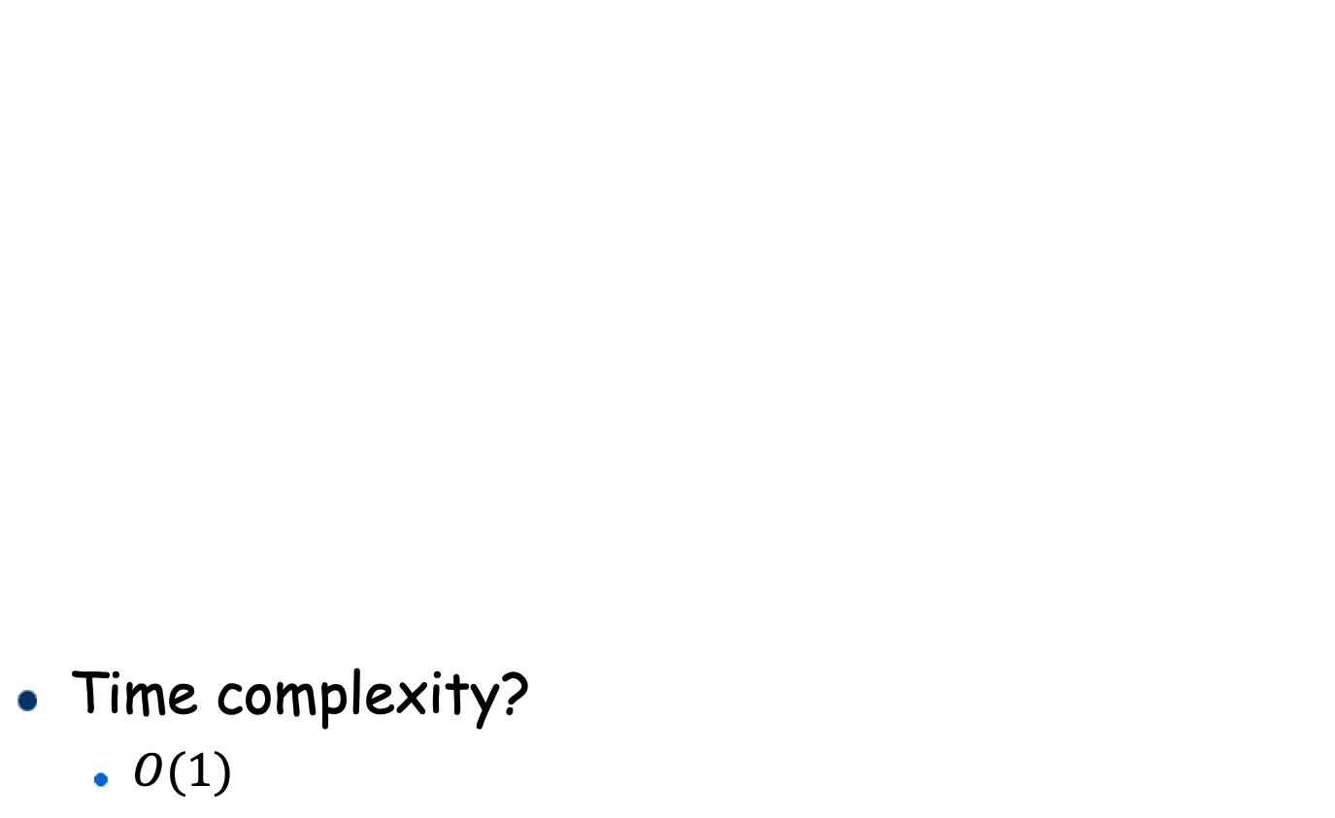
Prepend Operation Implementation
void prepend(int data, llist* list) C code
Time complexity?
$O(1)$
1
2
3
4
5
6
7
8
9
listNode* temp = (listNode*)malloc(1*sizeof(listNode));
temp->data = data;
if (list->head == NULL)
temp->link = NULL;
list->head = temp;
return;
temp->link = list->head;
list-> head = temp;
return;
Algorithm 3: prepend(data, list)
1
2
3
4
5
6
7
8
9
temp ← new allocated node
temp.data ← data
if list.head = NULL
temp.link ← NULL
list.head ← temp
return
temp.link ← list.head
list.head ← temp
return

Slide 27
Delete Front
Delete front: remove the first element in the linked list
Step 1: get the node the old head points to and make the head points to this node
Step 2: delete the old head
list.head
12
20
40
∅

Slide 28
Singly Linked List: Append Operation
Append: Add a new node to make it the last node in the sequence.
How to get the last node of the linked list?
Solution 1: We can traverse the whole linked list until it reaches the end.
Algorithm 4: last(list)
1
2
3
4
5
6
7
8
node ← list.head
if node = NULL
return NULL
next ← list.head.link
while next != NULL
node ← next
next ← next.link
return node
node
node
node
next
next
next
head
12
20
40
∅

Slide 29

Append Implementation
Append: Add a new node to make it the last node in the sequence.
How to get the last node of the linked list?
Solution 1: We can traverse the whole linked list until it reaches the end.
Algorithm 5: append(data, list)
1
2
3
4
5
6
7
8
if list.head = NULL
prepend(data, list)
return
lastnode ← last(list)
temp ← new allocated node
temp.data ← data
temp.link ← NULL
lastnode.link ← temp
Time complexity?
$O(n)$

Slide 30

Append Implementation with Constant Time
Append: Add a new node to make it the last node in the sequence.
Solution 2: record the last node of the list.
Step 1: allocate a new node
Step 2: update new node
Step 3: make the new node point to NULL
Step 4: make the old tail points to the new node
Step 5: update the tail to point to the new node
head
tail
tail
Time complexity?
$O(1)$
12
20
40
∅
50
∅

Slide 31
Append Implementation with Constant Time
How to design?
Maintain a tail pointer in the list data type
When do we need to update the tail during prepend/append?
Case 1: prepend a node when the list is empty
Case 2: append in all cases
Algorithm 5: append(data, list)
1
2
3
4
5
6
7
8
9
10
if list.head = NULL
prepend(data, list)
list.tail ← list.head
return
lastnode ← list.tail
temp ← new allocated node
temp.data ← data
temp.link ← NULL
lastnode.link ← temp
List.tail ← temp
1
2
3
4
typedef struct llist{ listNode* head;
listNode* tail; }llist;

Slide 32
Delete last
No constant time solution for singly linked list
Why?
How to get the previous node of the tail?
We need to traverse all the nodes in the list
head
tail
12
20
21
…
40
∅

Slide 33
Singly Linked List: Insert Operation
Insert: add a new node after a given node prev in the linked list
Step 1: Allocate a new node;
Step 2: update new node;
Step 3: make the new node point to the node linked by prev
Step 4: make prev point to the new node
data
link
12
20
40
∅
n1
n2
n3
15
New node: insert after n1

Slide 34
Singly Linked List: Delete Operation
Delete: delete a node lnode after a given node prev in the linked list
Step 1: get the node lnext pointed by lnode and make the prev point to lnext
Step 2: free the memory allocated to lnode
12
20
40
∅
n1
n2
n3
delete n2

Slide 35
Pros: Singly Linked List
It requires less space than doubly linked list as we only need to store one pointer (or a link) to the next node.
The deletion of a node in the front of the linked list is very easy.
It is proper for some operations that need the accessibility of a node in the forward direction.

Slide 36
Cons: Singly Linked List
We can only traverse from one to the next, and we cannot traverse from one to its previous
If we want to know its previous, we need to search from the head.
Deleting an element requires the knowledge of its previous node (insertion usually needs to specify the position, so it is fine)

